Slide 1


Data Analysis Using
Python
Lecture-5
www.bennett.edu.in
www.bennett.edu.in

Slide 2
Data Mining
Why is data mining important?
Data mining is a crucial component of successful analytics initiatives in organizations. Data specialists can use the information it generates in business intelligence (BI) and advanced analytics applications that involve analysis of historical data, as well as real-time analytics applications that examine streaming data as it's created or collected.
Effective data mining aids in various aspects of planning business strategies and managing operations. This includes customer-facing functions, such as marketing, advertising, sales and customer support, as well as manufacturing, supply chain management (SCM), finance and human resources (HR). Data mining supports fraud detection, risk management, cybersecurity planning and many other critical business use cases. It also plays an important role in other areas, including healthcare, government, scientific research, mathematics and sports.

Slide 3
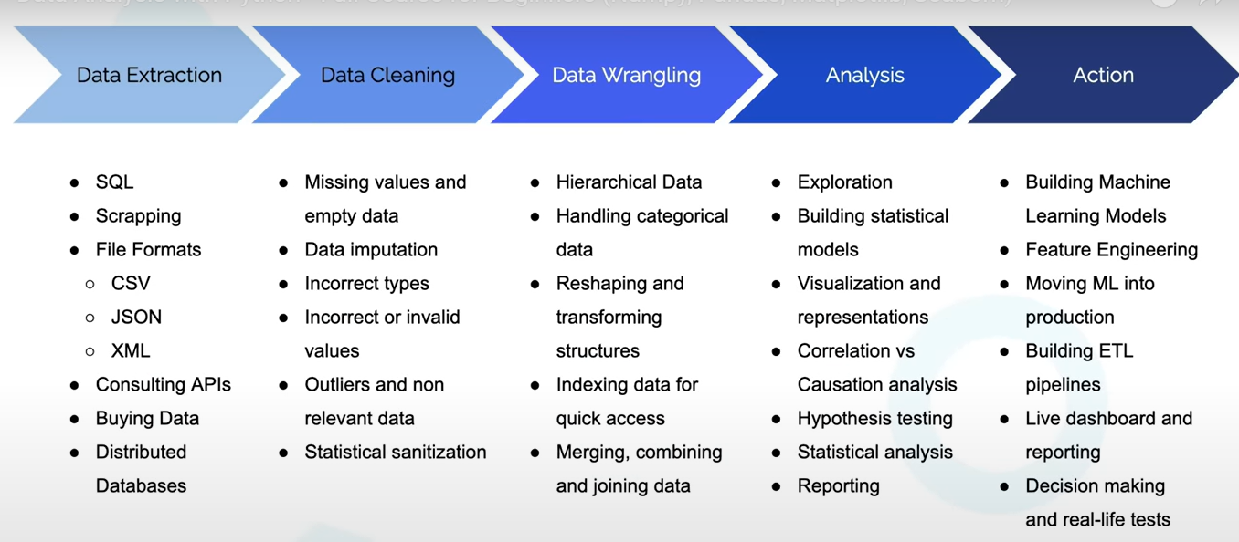

Data Preprocessing

Slide 4
Data Preprocessing
Data Preprocessing: An Overview
  Data Quality
  Major Tasks in Data Preprocessing
Data Cleaning
Data Integration
Data Reduction
Data Transformation and Data Discretization
Summary

Slide 5
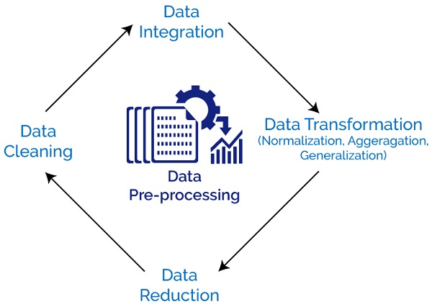
Why Data Preprocessing is Required
Raw data can be messy and contain errors, inconsistencies, and missing values, which can lead to incorrect conclusions during analysis. Preprocessing can help remove these issues by transforming the data into a clean, usable format that machines can process.

Slide 6
Data descriptiom
three most important methods to take basic insights from any data.
1 - dataframe.dtypes dtypes method is useful to see the data types of all the features of our data. By this method, you get to know what are the incorrect data types in our data that we need to correct.
2 - dataframe.describe() describe() method is useful to get the summary statistics of the dataset.
3 - dataframe.info() info() method is useful to get the overall statistics of our dataset about memory consumption, non-null values and data types.

Slide 7
Why Preprocess the Data?
Preprocessing of data is mainly to check the data quality. The quality can be checked by the following:
Accuracy: To check whether the data entered is correct or not.
Completeness: To check whether the data is available or not recorded.
Consistency: To check whether the same data is kept in all the places that do or do not match.
Timeliness: The data should be updated correctly.
Believability: The data should be trustable.
Interpretability: The understandability of the data.

Slide 8
The quality of data is checked based on its accuracy, completeness, consistency, timeliness, believability, and interpretability.
The 4 major tasks in data preprocessing are data cleaning, data integration, data reduction, and data transformation.

Slide 9
Major Tasks in Data Preprocessing
Data cleaning
  Fill in missing values, smooth noisy data, identify or remove outliers, and resolve inconsistencies
Data integration
  Integration of multiple databases, data cubes, or files
Data reduction
  Dimensionality reduction
  Numerosity reduction
  Data compression
Data transformation and data discretization
  Normalization
  Concept hierarchy generation

Slide 10
Data Preprocessing
Data Preprocessing: An Overview
  Data Quality
  Major Tasks in Data Preprocessing
Data Cleaning
Data Integration
Data Reduction
Data Transformation and Data Discretization
Summary

Slide 11
Data Cleaning
Data in the Real World Is Dirty: Lots of potentially incorrect data, e.g., instrument faulty, human or computer error, transmission error
  incomplete: lacking attribute values, lacking certain attributes of interest, or containing only aggregate data
    e.g., Occupation=“ ” (missing data)
  noisy: containing noise, errors, or outliers
    e.g., Salary=“−10” (an error)
  inconsistent: containing discrepancies in codes or names, e.g.,
    Age=“42”, Birthday=“03/07/2010”
    Was rating “1, 2, 3”, now rating “A, B, C”
    discrepancy between duplicate records
  Intentional (e.g., disguised missing data)
    Jan. 1 as everyone’s birthday?

Slide 12
Incomplete (Missing) Data
Data is not always available
  E.g., many tuples have no recorded value for several attributes, such as customer income in sales data
Missing data may be due to
  equipment malfunction
  inconsistent with other recorded data and thus deleted
  data not entered due to misunderstanding
  certain data may not be considered important at the time of entry
  not register history or changes of the data
Missing data may need to be inferred

Slide 13
Data Cleaning
Data cleaning is the process of removing incorrect data, incomplete data, and inaccurate data from the datasets, and it also replaces the missing values. Here are some techniques for data cleaning:
https://drive.google.com/file/d/1XYCScDb6tyOWoZKpvBTcWHnkHSsFwprZ/view?usp=sharing

Slide 14
Handling Missing Values
Standard values like “Not Available” or “NA” can be used to replace the missing values.
Missing values can also be filled manually, but it is not recommended when that dataset is big.
The attribute’s mean value can be used to replace the missing value when the data is normally distributed
wherein in the case of non-normal distribution median value of the attribute can be used.
While using regression or decision tree algorithms, the missing value can be replaced by the most probable value.

Slide 15
Handling Noisy Data :Noisy generally means random error or containing unnecessary data points.
Binning: This method is to smooth or handle noisy data. First, the data is sorted then, and then the sorted values are separated and stored in the form of bins.
  Smoothing by bin mean method: In this method, the values in the bin are replaced by the mean value of the bin;
  Smoothing by bin median: In this method, the values in the bin are replaced by the median value;
  Smoothing by bin boundary: In this method, the using minimum and maximum values of the bin values are taken, and the closest boundary value replaces the values.

Slide 16
Handling Noisy Data
Regression: This is used to smooth the data and will help to handle data when unnecessary data is present.
Clustering: This is used for finding the outliers and also in grouping the data. Clustering is generally used in unsupervised learning.

Slide 17

Preprocessing involves the following aspects:
missing values
data formatting
data normalization
data standardization
data binning

Slide 18
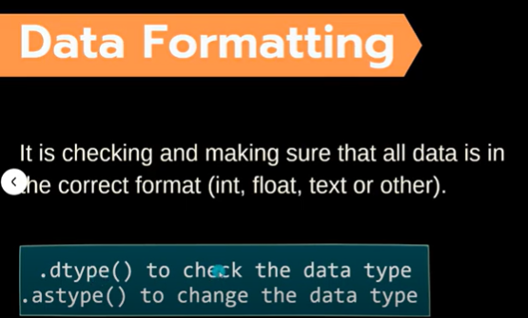

Slide 19
data formatting
Data formatting is the process of transforming data into a common format, which helps users to perform comparisons.
An example of not formatted data is the following: the same entity is referred in the same column with different values, such as New York and NY.

Slide 20
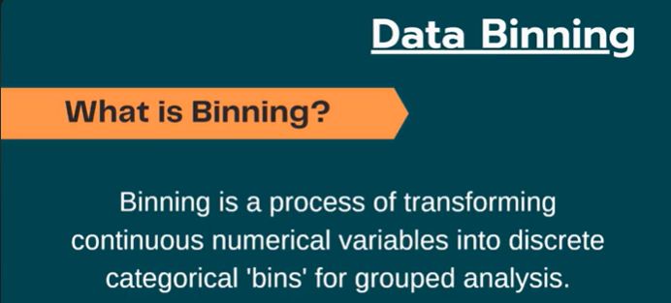
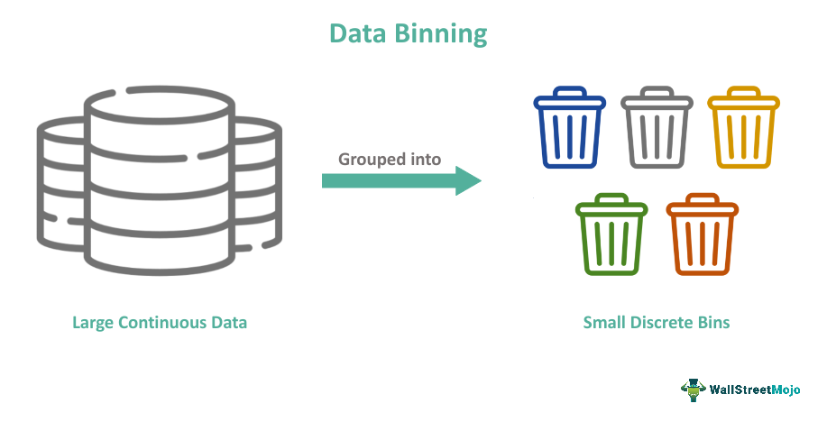
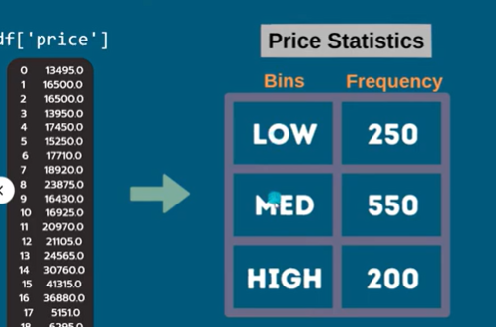
Data Binningv

Slide 21
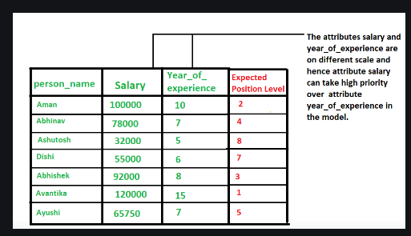
Data Normalization
NEED: Normalization is generally required when we are dealing with attributes on a different scale, it may lead to a dilution in effectiveness of an important equally important attribute(on lower scale) because of other attribute having values on larger scale.
when multiple attributes are there but attributes have values on different scales, this may lead to poor data models while performing data mining operations.
All attributes are normalized to bring on same scale.

Slide 22
Data Normalization
Data normalization is a technique used in data mining to transform the values of a dataset into a common scale. This is important because many machine learning algorithms are sensitive to the scale of the input features and can produce better results when the data is normalized.

Slide 23
Contd
There are several different normalization techniques that can be used in data mining, including:
Min-Max normalization: This technique scales the values of a feature to a range between 0 and 1. This is done by subtracting the minimum value of the feature from each value, and then dividing by the range of the feature.
Z-score normalization: This technique scales the values of a feature to have a mean of 0 and a standard deviation of 1. This is done by subtracting the mean of the feature from each value, and then dividing by the standard deviation.
Decimal Scaling: This technique scales the values of a feature by dividing the values of a feature by a power of 10.

Slide 24
Contd
Logarithmic transformation: This technique applies a logarithmic transformation to the values of a feature. This can be useful for data with a wide range of values, as it can help to reduce the impact of outliers.
Root transformation: This technique applies a square root transformation to the values of a feature. This can be useful for data with a wide range of values, as it can help to reduce the impact of outliers.
It’s important to note that normalization should be applied only to the input features, not the target variable, and that different normalization technique may work better for different types of data and models.

Slide 25
Data Transformation/Normaliztion
A function that maps the entire set of values of a given attribute to a new set of replacement values s.t. each old value can be identified with one of the new values
Methods
  Smoothing: Remove noise from data
  Attribute/feature construction
    New attributes constructed from the given ones
  Aggregation: Summarization, data cube construction
  Normalization: Scaled to fall within a smaller, specified range
    min-max normalization
    z-score normalization
    normalization by decimal scaling
  Discretization: Concept hierarchy climbing

Slide 26
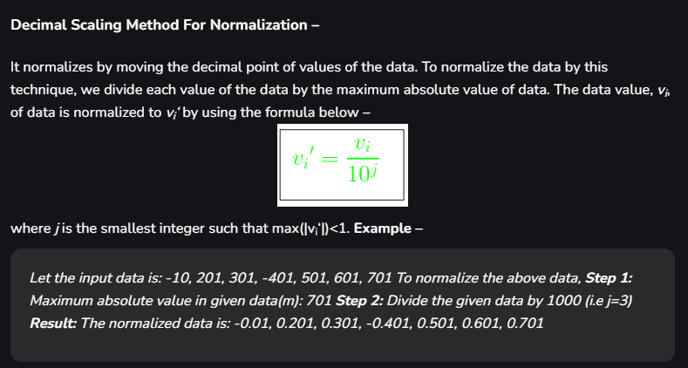

Slide 27
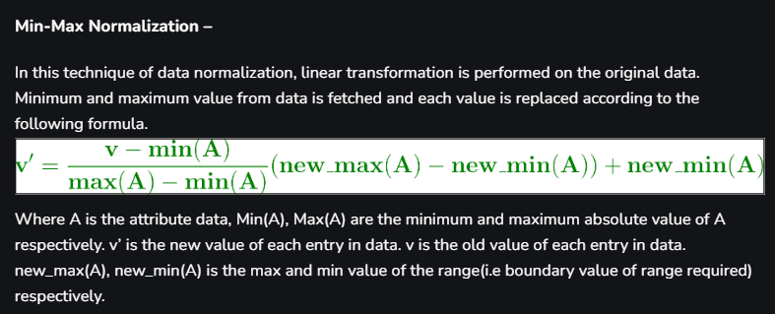

Slide 28





Normalization
Min-max normalization: to [new_min_{A}, new_max_{A}]
  Ex. Let income range $12,000 to $98,000 normalized to [0.0, 1.0]. Then $73,000 is mapped to
Z-score normalization (μ: mean, σ: standard deviation):
  Ex. Let μ = 54,000, σ = 16,000. Then
Normalization by decimal scaling
Where j is the smallest integer such that Max(|ν’|) < 1

Slide 29
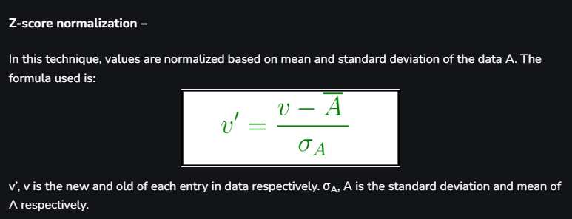
Data Mining: Concepts and Techniques

Slide 30
Advantages of Data Normalization
Data normalization in data mining can have a number of advantages and disadvantages. Advantages:
Improved performance of machine learning algorithms: help to reduce the impact of outliers and improve the accuracy of the model.
Better handling of outliers:
Improved interpretability of results: as the inputs will be on a common scale.
Better generalization: by reducing the impact of outliers and by making the model less sensitive to the scale of the inputs.

Slide 31
Disadvantages of Normalization
Loss of information: Normalization can result in a loss of information if the original scale of the input features is important.
Impact on outliers: Normalization can make it harder to detect outliers as they will be scaled along with the rest of the data.
Additional computational costs: Normalization can add additional computational costs to the data mining process, as it requires additional processing time to scale the data.

Slide 32
Discretization
Three types of attributes
  Nominal—values from an unordered set, e.g., color, profession
  Ordinal—values from an ordered set, e.g., military or academic rank
  Numeric—real numbers, e.g., integer or real numbers
Discretization: Divide the range of a continuous attribute into intervals
  Interval labels can then be used to replace actual data values
  Reduce data size by discretization
  Supervised vs. unsupervised
  Split (top-down) vs. merge (bottom-up)
  Discretization can be performed recursively on an attribute
  Prepare for further analysis, e.g., classification

Slide 33
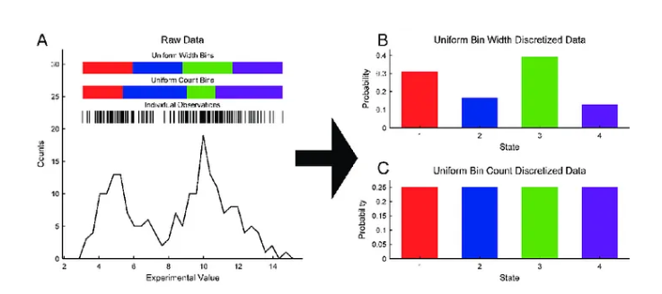
Discretization

Slide 34
Steps of Discretization
Step 1: Sorting the continuous values of the feature to be
discretized.
Step 2: Evaluating a cut point for splitting or adjacent
intervals for merging.
Step 3: Splitting or merging intervals of continuous values
according to some defined criterion.
Step 4: Stopping at some point.

Slide 35
Typical Methods of Data Discretization
Binning
Histogram analysis
Cluster analysis
Decision tree analysis
Correlation analysis

Slide 36
Binning vs. Histogram
Binning and histograms are both techniques used in data analysis to understand the distribution of data,
Binning is the process of dividing continuous data into discrete intervals or "bins."
Histogram is a graphical representation that displays the distribution of a dataset by showing the frequency of data points that fall into each bin.
Key Differences
Binning:
  Purpose: To categorize continuous data into discrete intervals.
  Usage: Often used in pre-processing, such as for creating features in machine learning or for summary statistics.
Histogram:
  Purpose: To visually represent the frequency distribution of a dataset.
  Usage: Used to understand the distribution and spread of the data.
https://colab.research.google.com/drive/1vAEg1q9mv-j2jv8cRqxwCjbkwVPK7-Q3?usp=sharing

Slide 37
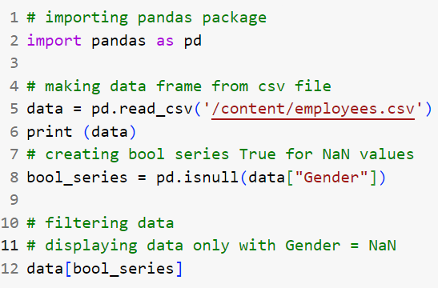

Slide 38
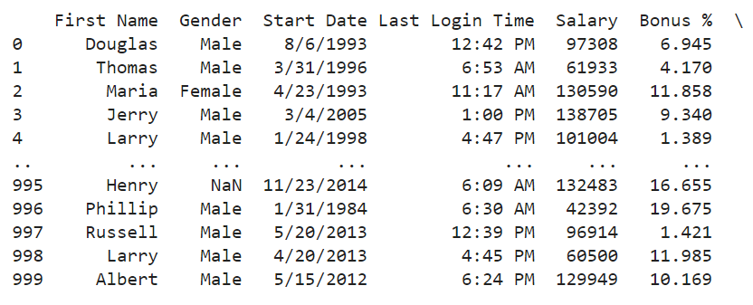

Slide 39
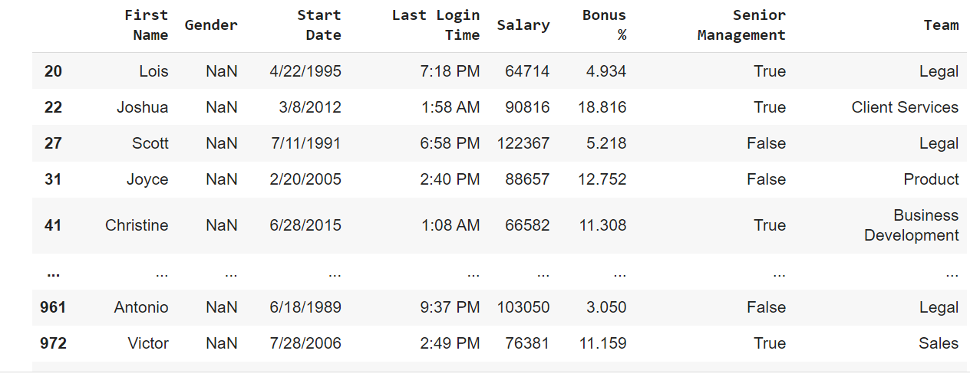

Slide 40
Data Merging
Data merging is the process of combining data from multiple sources, often disparate or heterogeneous, into a single, unified dataset.
like assembling the pieces of a jigsaw puzzle to create a complete picture.
It brings together information from various sources, such as databases, spreadsheets, files, or even different departments within an organization, into a coherent and structured format.
https://colab.research.google.com/drive/1vAEg1q9mv-j2jv8cRqxwCjbkwVPK7-Q3?usp=sharing
https://guides.nyu.edu/quant/merge

Slide 41
Contd.
1. Concatenation :
Concatenation involves combining datasets by stacking them on top of each other. This method is commonly used when you have two or more datasets with the same columns, and you want to merge them vertically
2. Joining :
Joining, also known as merging, involves combining datasets by matching a common column or key. It’s similar to a database join operation. This method is used when you have datasets with related information that can be linked using a unique identifier or key column.

Slide 42
Contd.
3. Appending:
Appending is similar to concatenation but is used when you want to add new rows to an existing dataset. It’s often employed when data is collected over time and needs to be continuously updated.
4. Union:
A union operation combines datasets with the same structure by stacking them on top of each other. Unlike concatenation, union doesn’t require the datasets to have the same columns in the same order. It simply appends rows from one dataset to another.

Slide 43
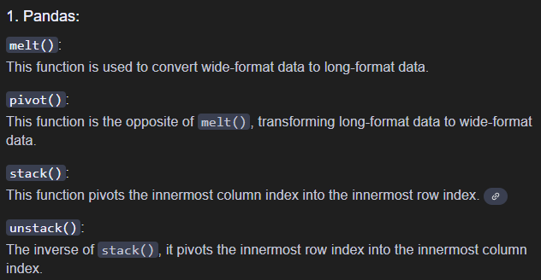
Data reshaping
Data reshaping in Python refers to the process of changing the structure or layout of your data to facilitate analysis or better suit your needs. Here's a breakdown of common techniques:

Slide 44
Data reshaping in NUMPY
1. Reshape
The reshape function changes the shape of an array to a specified shape. The number of elements must remain the same.
2. Flatten
flatten returns a 1D array from any N-dimensional array. It copies the data to create a new array.
3. Ravel
ravel also returns a 1D array, but it tries to avoid copying the data if possible. It's a more memory-efficient version of flatten.
4. Transpose
transpose swaps the axes of an array, effectively flipping it over its diagonal.
5. Swapaxes
swapaxes swaps two specified axes of an array, which can be useful for more complex reshaping tasks.
6. Expand_dims
expand_dims adds a new axis (dimension) to an array, which can be useful when you need to change the shape of an array for broadcasting or other operations.

Slide 45
Aggregation functions
Common Aggregation Functions in Pandas
sum(): Computes the sum of values.
mean(): Computes the mean (average) of values.
median(): Computes the median (middle value) of values.
count(): Counts the number of non-null values.
min(): Finds the minimum value.
max(): Finds the maximum value.
std(): Computes the standard deviation of values.
var(): Computes the variance of values.
prod(): Computes the product of values.
describe(): Generates descriptive statistics like mean, std, min, max, etc., for each column.

Slide 46
Contd. (Aggre
Direct Aggregation on a DataFrame
Aggregation with groupby(): calculate aggregations by category or group, you use the groupby() method along with an aggregation function.
Applying Multiple Aggregation Functions: You can apply multiple aggregation functions at once using the agg() method.
Custom Aggregation Function:You can also define and apply custom aggregation functions.
Descriptive Statistics: describe() provides a quick summary of common aggregations like mean, count, std, min, max, etc.

Slide 47
Data Wrangling
Data wrangling is the process of transforming and structuring data from one raw form into a desired format with the intent of improving data quality and making it more consumable and useful for analytics or machine learning.
Data Wrangling is the process of gathering, collecting, and transforming Raw data into another format for better understanding, decision-making, accessing, and analysis in less time. Data Wrangling is also known as Data Munging.

Slide 48
Data Manipulation

Slide 49
How to Handle Missing Data?
Ignore the tuple: usually done when class label is missing (when doing classification)—not effective when the % of missing values per attribute varies considerably
Fill in the missing value manually: tedious + infeasible?
Fill in it automatically with
  a global constant : e.g., “unknown”, a new class?!
  the attribute mean
  the attribute mean for all samples belonging to the same class: smarter
  the most probable value: inference-based such as Bayesian formula or decision tree

Slide 50
Noisy Data
Noise: random error or variance in a measured variable
Incorrect attribute values may be due to
  faulty data collection instruments
  data entry problems
  data transmission problems
  technology limitation
  inconsistency in naming convention
Other data problems which require data cleaning
  duplicate records
  incomplete data
  inconsistent data

Slide 51
How to Handle Noisy Data?
Binning
  first sort data and partition into (equal-frequency) bins
  then one can smooth by bin means, smooth by bin median, smooth by bin boundaries, etc.
Regression
  smooth by fitting the data into regression functions
Clustering
  detect and remove outliers
Combined computer and human inspection
  detect suspicious values and check by human (e.g., deal with possible outliers)

Slide 52
Data Cleaning as a Process
Data discrepancy detection
  Use metadata (e.g., domain, range, dependency, distribution)
  Check field overloading
  Check uniqueness rule, consecutive rule and null rule
  Use commercial tools
    Data scrubbing: use simple domain knowledge (e.g., postal code, spell-check) to detect errors and make corrections
    Data auditing: by analyzing data to discover rules and relationship to detect violators (e.g., correlation and clustering to find outliers)
Data migration and integration
  Data migration tools: allow transformations to be specified
  ETL (Extraction/Transformation/Loading) tools: allow users to specify transformations through a graphical user interface
Integration of the two processes
  Iterative and interactive (e.g., Potter’s Wheels)

Slide 53
Data Preprocessing
Data Preprocessing: An Overview
  Data Quality
  Major Tasks in Data Preprocessing
Data Cleaning
Data Integration
Data Reduction
Data Transformation and Data Discretization
Summary

Slide 54
Data Integration
Data integration:
  Combines data from multiple sources into a coherent store
Schema integration: e.g., A.cust-id ≡ B.cust-#
  Integrate metadata from different sources
Entity identification problem:
  Identify real world entities from multiple data sources, e.g., Bill Clinton = William Clinton
Detecting and resolving data value conflicts
  For the same real world entity, attribute values from different sources are different
  Possible reasons: different representations, different scales, e.g., metric vs. British units

Slide 55
Handling Redundancy in Data Integration
Redundant data occur often when integration of multiple databases
  Object identification: The same attribute or object may have different names in different databases
  Derivable data: One attribute may be a “derived” attribute in another table, e.g., annual revenue
Redundant attributes may be able to be detected by correlation analysis and covariance analysis
Careful integration of the data from multiple sources may help reduce/avoid redundancies and inconsistencies and improve mining speed and quality

Slide 56

Correlation Analysis (Nominal Data)
Χ² (chi-square) test
The larger the Χ² value, the more likely the variables are related
The cells that contribute the most to the Χ² value are those whose actual count is very different from the expected count
Correlation does not imply causality
  # of hospitals and # of car-theft in a city are correlated
  Both are causally linked to the third variable: population

Slide 57
Chi-Square Calculation: An Example
Χ² (chi-square) calculation (numbers in parenthesis are expected counts calculated based on the data distribution in the two categories)
It shows that like_science_fiction and play_chess are correlated in the group
 | Play chess | Not play chess | Sum (row)
Like science fiction | 250(90) | 200(360) | 450
Not like science fiction | 50(210) | 1000(840) | 1050
Sum(col.) | 300 | 1200 | 1500

Slide 58



Correlation Analysis (Numeric Data)
Correlation coefficient (also called Pearson’s product moment coefficient)
  where n is the number of tuples, and are the respective means of A and B, σ_{A} and σ_{B} are the respective standard deviation of A and B, and Σ(a_{i}b_{i}) is the sum of the AB cross-product.
If r_{A,B} > 0, A and B are positively correlated (A’s values increase as B’s). The higher, the stronger correlation.
r_{A,B} = 0: independent; r_{AB} < 0: negatively correlated

Slide 59



Correlation (viewed as linear relationship)
Correlation measures the linear relationship between objects
To compute correlation, we standardize data objects, A and B, and then take their dot product

Slide 60
Data Preprocessing
Data Preprocessing: An Overview
  Data Quality
  Major Tasks in Data Preprocessing
Data Cleaning
Data Integration
Data Reduction
Data Transformation and Data Discretization
Summary

Slide 61
Data Reduction
In machine learning, high-dimensional data refers to data with a large number of features or variables.
The curse of dimensionality is a common problem in machine learning, the performance of the model deteriorates as the number of features increases.
Model become complex.
High-dimensional data can also lead to overfitting, where the model fits the training data too closely and does not generalize well to new data.
Dimensionality reduction help to mitigate these problems by reducing the complexity of the model and improving its generalization performance. and feature extraction.

Slide 62
Data Reduction Strategies
Data reduction: Obtain a reduced representation of the data set that is much smaller in volume but yet produces the same (or almost the same) analytical results
Why data reduction? — A database/data warehouse may store terabytes of data. Complex data analysis may take a very long time to run on the complete data set.
Data reduction strategies
  Dimensionality reduction, e.g., remove unimportant attributes
    Wavelet transforms
    Principal Components Analysis (PCA)
    Feature subset selection, feature creation
  Numerosity reduction (some simply call it: Data Reduction)
    Regression and Log-Linear Models
    Histograms, clustering, sampling
    Data cube aggregation
  Data compression

Slide 63
Feature Selection:
Feature selection involves selecting a subset of the original features that are most relevant to the problem at hand.
Retain the most important features.
Methods for feature selection,
  filter methods: Filter methods rank the features based on their relevance to the target variable
  wrapper methods: use the model performance as the criteria for selecting features
  embedded methods: Combine feature selection with the model training process.
Feature Extraction: Feature extraction involves creating new features by combining or transforming the original features.
Methods :
  principal component analysis (PCA),
  linear discriminant analysis (LDA),
  t-distributed stochastic neighbor embedding (t-SNE).

Slide 64
Data Reduction 1: Dimensionality Reduction
Curse of dimensionality
  When dimensionality increases, data becomes increasingly sparse
  Density and distance between points, which is critical to clustering, outlier analysis, becomes less meaningful
  The possible combinations of subspaces will grow exponentially
Dimensionality reduction
  Avoid the curse of dimensionality
  Help eliminate irrelevant features and reduce noise
  Reduce time and space required in data mining
  Allow easier visualization
Dimensionality reduction techniques
  Wavelet transforms
  Principal Component Analysis
  Supervised and nonlinear techniques (e.g., feature selection)

Slide 65



Mapping Data to a New Space
Fourier transform
Wavelet transform
Two Sine Waves
Two Sine Waves + Noise
Frequency

Slide 66

What Is Wavelet Transform?
Decomposes a signal into different frequency subbands
  Applicable to n-dimensional signals
Data are transformed to preserve relative distance between objects at different levels of resolution
Allow natural clusters to become more distinguishable
Used for image compression

Slide 67
Why Wavelet Transform?
Use hat-shape filters
  Emphasize region where points cluster
  Suppress weaker information in their boundaries
Effective removal of outliers
  Insensitive to noise, insensitive to input order
Multi-resolution
  Detect arbitrary shaped clusters at different scales
Efficient
  Complexity O(N)
Only applicable to low dimensional data

Slide 68
Principal Component Analysis (PCA)
Find a projection that captures the largest amount of variation in data
The original data are projected onto a much smaller space, resulting in dimensionality reduction. We find the eigenvectors of the covariance matrix, and these eigenvectors define the new space
x₂
e
x₁

Slide 69
Principal Component Analysis (Steps)
Given N data vectors from n-dimensions, find k ≤ n orthogonal vectors (principal components) that can be best used to represent data
  Normalize input data: Each attribute falls within the same range
  Compute k orthonormal (unit) vectors, i.e., principal components
  Each input data (vector) is a linear combination of the k principal component vectors
  The principal components are sorted in order of decreasing “significance” or strength
  Since the components are sorted, the size of the data can be reduced by eliminating the weak components, i.e., those with low variance (i.e., using the strongest principal components, it is possible to reconstruct a good approximation of the original data)
Works for numeric data only

Slide 70
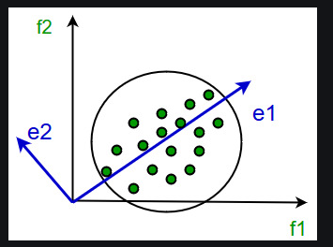
contd

Slide 71
Data Reduction 2: Numerosity Reduction
Reduce data volume by choosing alternative, smaller forms of data representation
Parametric methods (e.g., regression)
  Assume the data fits some model, estimate model parameters, store only the parameters, and discard the data (except possible outliers)
  Ex.: Log-linear models—obtain value at a point in m-D space as the product on appropriate marginal subspaces
Non-parametric methods
  Do not assume models
  Major families: histograms, clustering, sampling, …

Slide 72
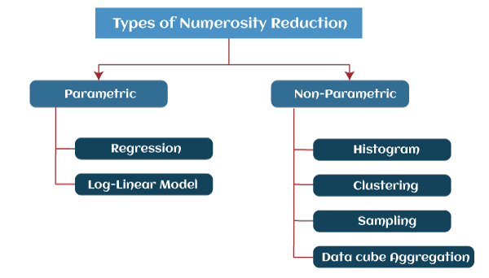

Slide 73
Parametric Data Reduction: Regression and Log-Linear Models
Linear regression
  Data modeled to fit a straight line
  Often uses the least-square method to fit the line
Multiple regression
  Allows a response variable Y to be modeled as a linear function of multidimensional feature vector
Log-linear model
  Approximates discrete multidimensional probability distributions

Slide 74
Regression Analysis
y
Y1
Regression analysis: A collective name for techniques for the modeling and analysis of numerical data consisting of values of a dependent variable (also called response variable or measurement) and of one or more independent variables (aka. explanatory variables or predictors)
The parameters are estimated so as to give a "best fit" of the data
Most commonly the best fit is evaluated by using the least squares method, but other criteria have also been used
Y1’
y = x + 1
X1
x
Used for prediction (including forecasting of time-series data), inference, hypothesis testing, and modeling of causal relationships

Slide 75
Regress Analysis and Log-Linear Models
Linear regression: Y = w X + b
  Two regression coefficients, w and b, specify the line and are to be estimated by using the data at hand
  Using the least squares criterion to the known values of Y₁, Y₂, …, X₁, X₂, ….
Multiple regression: Y = b₀ + b₁ X₁ + b₂ X₂
  Many nonlinear functions can be transformed into the above
Log-linear models:
  Approximate discrete multidimensional probability distributions
  Estimate the probability of each point (tuple) in a multi-dimensional space for a set of discretized attributes, based on a smaller subset of dimensional combinations
  Useful for dimensionality reduction and data smoothing

Slide 76

Histogram Analysis
Divide data into buckets and store average (sum) for each bucket
Partitioning rules:
  Equal-width: equal bucket range
  Equal-frequency (or equal-depth)

Slide 77
Clustering
Partition data set into clusters based on similarity, and store cluster representation (e.g., centroid and diameter) only
Can be very effective if data is clustered but not if data is “smeared”
Can have hierarchical clustering and be stored in multi-dimensional index tree structures
There are many choices of clustering definitions and clustering algorithms
Cluster analysis will be studied in depth in Chapter 10

Slide 78
Data Compression
String compression
  There are extensive theories and well-tuned algorithms
  Typically lossless, but only limited manipulation is possible without expansion
Audio/video compression
  Typically lossy compression, with progressive refinement
  Sometimes small fragments of signal can be reconstructed without reconstructing the whole
Time sequence is not audio
  Typically short and vary slowly with time
Dimensionality and numerosity reduction may also be considered as forms of data compression

